Slide 1
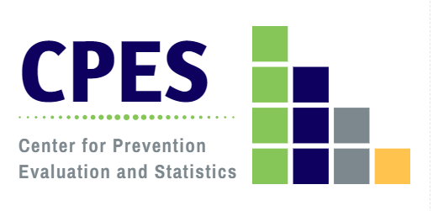
Connecticut’s Young Adults Speak Their Minds: Results of the Young Adults Statewide Survey
Connecticut Healthy Campus Initiative Virtual Meeting
Friday, November 13, 2020, 9:30 am
Jennifer Sussman, MFA
DMHAS Center for Prevention Evaluation and Statistics (CPES)
at UConn Health

Slide 2
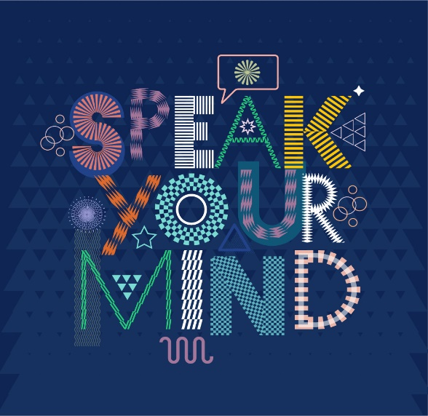
What is the Young Adults Statewide Survey?
The Young Adults Statewide Survey, or YASS, was a two phase, social marketing driven behavioral health survey of young adults (18-25);
Phase 1 (June 2019 – September 2019) was promoted through the SPEAK YOUR MIND social marketing campaign, developed in collaboration with Odonnell Company (LiveLOUD), and garnered 179 responses covering 59 of 169 towns (35%).
Phase 2 (November 2019 – June 2020) took a more direct approach, via promoted FaceBook advertising requesting participation with a link to the survey. This approach yielded 1257 respondents representing 149 of 169 towns (88%).

Slide 3
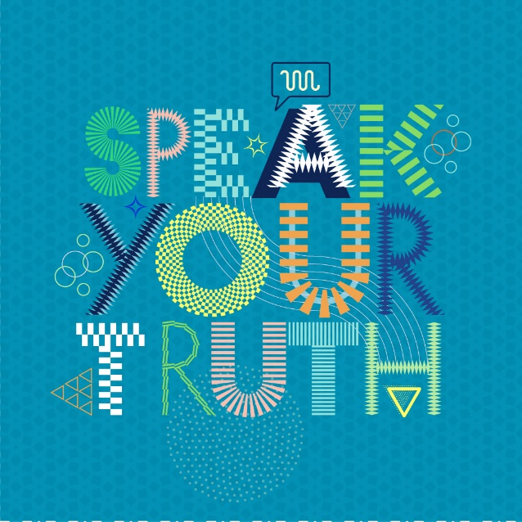
Phase 1 Campaign Creative
Marketing messages and artwork developed by Odonnell Company, with input from UConn Health and CPES.

Slide 4
Phase 2 FaceBook Ads

Slide 5
Why Conduct a Social Media Driven Survey of Connecticut’s Young Adults?
Young adults are an at risk population, for substance misuse and mental health issues;
While federal prevention initiatives have long targeted youth (12-17), prevention and opioid response initiatives have recently required data on 18-25 year olds;
future funding federal funding opportunities are likely to target this age group (data → funding);
While there are some available data on college students, and some information on 18-25 available through household surveys, young adults in the community are often under-represented, and not all results are available for this specific age group;
There are no established “best practices” for collecting data from young adults at large;
Traditional survey administration is expensive, and young adults not in school are difficult to find and engage;
Social media is utilized by young adults across lifestyles and circumstances.

Slide 6
Aims of the Young Adults Statewide Survey
Explore the feasibility of a social marketing driven survey of young adults in Connecticut, with outreach and support from DMHAS’ prevention partners;
Successfully collect reliable, representative data, across demographic characteristics and lifestyles, from 3,000 - 4,000 of CT’s young adults;
Provide respondents who need them with information on behavioral health and crisis intervention resources through the survey tool;
Disseminate results to CT’s young adults and key stakeholders, using the same social media pathways utilized for outreach and recruitment;
Use the survey results in concert with existing data resources to gain insight into young adult behavioral health experiences and behaviors;
Document and share our efforts and lessons learned, so that surveys like this can be replicated in the future.

Slide 7
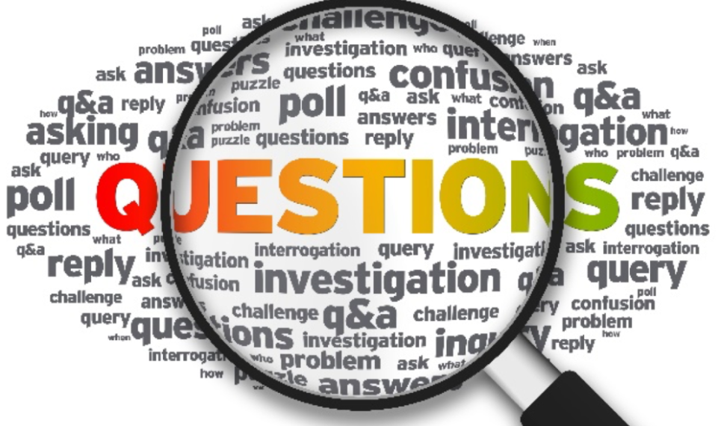

Slide 8
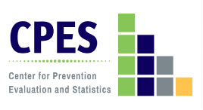
COVID Questions Added to the YASS April 10, 2020
In what ways has the COVID-19 pandemic affected your health and behaviors?
5 point Likert scale (large increase –large decrease)
18 elements assessed, across 10 domains:
Emotional well-being
Social Connectedness
Substance use/Gaming/Gambling
Boredom/Isolation
Mental focus/Motivation
Physical activity/health
Interpersonal/family conflict
Access to necessities
Financial security
Other
How important have the following been for you in coping with the effects of the COVID-19 pandemic?
5 point Likert scale (not important – very important, and N/A)
18 behaviors assessed, across 9 domains:
Focus on routine/school/work
Shift to technology (social, school, work, telehealth)
Isolation (limiting social, information)
Accessing information (news, social media)
Substance use
Creative pursuits (cooking, art)
Home improvement (cleaning, projects)
Health improvement (exercise, meditation)
Other

Slide 9
Young Adults and COVID-19
Young adults 20-29 are the most represented age group in CT COVID cases, relative to their population size;
While physically healthy YAs may be less likely to die of COVID than other groups, YAs are at high risk for negative behavioral health effects as a result of the COVID pandemic.
Source: CT Data Collaborative COVID Dashboard: https://public.tableau.com/profile/connecticut.state.data.center#!/vizhome/ConnecticutCOVID-19CaseTracking/CTdataCollaborativeCOVID-19
Notes:
Effects include anxiety, depression, isolation, financial insecurity, etc.

Slide 11
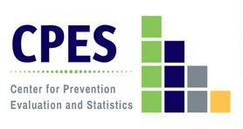
Respondent Age: Young Adults Statewide Survey (YASS) 2020

Slide 12
Respondent Gender Identity: Young Adults Statewide Survey (YASS) 2020
Notes:
Slightly lower % of male respondents than phase 1

Slide 13
Respondent Race/Ethnicity: Young Adults Statewide Survey (YASS) 2020
Notes:
Slightly higher % of whites, lower non-whites

Slide 14
Respondent Work or School Status: Young Adult Statewide Survey (YASS) 2020
Student, full-time
Student, part-time
Employed full-time
Employed part-time
Stay at home parent
Not employed, looking for work
Not employed, not looking for work
Notes:
56% students, 62% employed, 14% unemployed, 2% stay at home, 2% in the military

Slide 15
Respondent Living Arrangement: Young Adults Statewide Survey (YASS) 2020
With parent/
family
College campus
House/apartment (alone/roommate(s))
With spouse or partner
Institutional setting
Homeless/shelter/
emergency housing

Slide 16
“I can't believe that ecigs have become so popular among people my age. When I was younger, I was convinced that we were going to be the generation that would end smoking and tobacco use, but I can't believe young people are naive enough to fall for it.”
“I relapsed after having almost 6 months clean from fentanyl because of my mental health issues. I stopped taking my prescribed mental health and substance abuse prevention medication and stopped attending NA/AA meetings and stopped reaching out to my support network which resulted in relapsing on fentanyl. I urge anyone who is in active addiction to reach out for help because it does get better.”
“I do not abuse substances because I know the damage they cause to health and can worsen my emotional disorders”
Substance Use and Related Indicators
“Weed should be legal because it helps more people with mental heath then most medications do.”
“It's honestly just sad how misinformed we are growing up. I grew up with the dare program. The gist was that all drugs are bad, no exceptions, and that if you did drugs, you are a bad person. I don't think that's true.”
“People going through substance abuse need support and help. Regardless of what people think of addicts, they are still people and are struggling and most of them want a normal life.”
“I believe Connecticut could have way more easier options and openings for professionals help with drug addiction.”
“I do use edibles (marijuana) and/or a dab pen a few times a week because it helps me calm down”

Slide 17
Lifetime Substance Use: Young Adults Statewide Survey (YASS) 2020
alcohol
(1+ drinks)
heavy alcohol use*
cigarettes,
tobacco products
vape/
e-cigarettes
marijuana or hashish
cocaine
heroin or fentanyl
prescription drugs (non-medical use)
OTC medications (non-medical use)
*heavy alcohol use: 5 or more drinks on one occasion

Slide 18
Current (Past Month) Substance Use: Young Adults Statewide Survey (YASS) 2020
N = 777
alcohol
(1+ drinks)
heavy alcohol use*
cigarettes,
tobacco products
vape/
e-cigarettes
marijuana or hashish
cocaine
heroin or fentanyl
prescription drugs (non-medical use)
OTC medications (non-medical use)
*heavy alcohol use: 5 or more drinks on one occasion
18

Slide 19
Substances Used by E-cigarette Users in Vaping Devices: Young Adults Statewide Survey (YASS) 2020

Slide 20
Impaired Driving, Past Year: Young Adults Statewide Survey (YASS) 2020

Slide 21
Reasons for Past Year Substance Use: Young Adults Statewide Survey (YASS) 2020
Deal w mental health issues
Help me focus
Feel better about myself
Comfort in social situations
Feel less alone
Escape my problems
Friends were doing it
I crave/ need it
Experimentation
Boredom
To have a good time

Slide 22
Reasons for Avoiding or Limiting Substance Use: Young Adults Statewide Survey (YASS) 2020

Slide 23
”Mental health needs to be integrated into the school systems starting in elementary school. There needs to be more exposure and education on mental health as a whole starting from a younger age.“
“We have a severe mental health crisis in the US. It is a huge problem especially among teens and young adults.”
“EVERYONE should be getting help no matter what.”
“We’re failing today’s youth by ignoring the trauma and stress they are put through since birth.”
“Focusing on mental health is just as important and focusing on physical health.”
Mental Health and Service Utilization
“I wish the stigma about mental health would go away do more people would feel comfortable reaching out to parents or friends when they need help.”
“I feel like there is a mental health crisis, but it’s not caused by video games or drugs. Often people use those things as coping mechanisms, but they’re not the source.“
“Therapy is becoming less taboo which is amazing.”
“I can easily say none of us were informed on the signs of suicide. if we had been, it would have been prevented.”
“Be more educated about how ok it is to seek help.
School counseling centers are a great place to start.”

Slide 24
Reported Anxiety: Young Adults Statewide Survey (YASS) 2020
Reported that anxiety greatly affected their work, life, or relationships

Slide 25
Depression and Suicide: Young Adults Statewide Survey (YASS) 2020

Slide 26
Receipt of Substance Use and Mental Health Services, Past Year: Young Adults Statewide Survey (YASS) 2020
37% of respondents reported taking medication prescribed for mental health issues in the past year

Slide 27
“Gambling is probably something that should be less available.”
“Video games are one of the most important parts of my life because it's the way I stay socially connected to all of my hometown friends and people I know across the country. It's my favorite form of entertainment and I think it's more engaging than sitting around mindlessly watching Netflix or other streaming TV or movie programs.”
“I do think that spending too much time playing/obsessively playing can be damaging to one's mental health. It can easily become a consuming hobby.”
“Video games are good to escape problems I can't deal with.”
Gaming and Gambling Behavior
“Addiction to … loot boxes in video games needs to be taken far more seriously as a legitimate issue akin to gambling addiction. It is a largely unregulated market that disproportionately affects young people and there are not many resources available for help or even recognizing it.”
“I am concerned that loot boxes in games could be a gateway into gambling for some young people.”
“I know a lot of people who are more addicted to video games than anything else but it doesn’t get talked about as much.”

Slide 28
Hours Spent Video Gaming, Past Year: Young Adults Statewide Survey (YASS) 2020

Slide 29
Video Game Related Behaviors: Young Adults Statewide Survey (YASS) 2020
Play to escape real life problems
Spend more money than you can afford on game purchases

Slide 30
Frequency of Gambling Behavior, Past Year: Young Adults Statewide Survey (YASS) 2020

Slide 31
Gambling Related Behaviors: Young Adults Statewide Survey (YASS) 2020

Slide 32
“My mom’s a nurse so I’ve been a bit worried for her safety.”
“Work Life Balance: Large Decrease.
Stress related to work: Large Increase.”
“Trying to get a degree in a pandemic feels like trying to dig yourself out of quicksand with a spoon.”
“Watching the news makes me mad seeing how many people are careless so I try to avoid to keep from being constantly emotional but I still need enough news to be up-to-date on what is going on.”
“My life literally just became a huge mess.”
COVID-19
“I feel like I’m suffocating in my house.”
“It has been near impossible to get and keep food.”
“I have a secure job and working from home has greatly decreased my stress. Even without being able to go out I feel I have more freedom now…. I am realizing how unnecessary a 40 hour workweek is.”
“It gave me space to use drugs that would normally interfere with my normal routine. These allowed me deeper introspection… an open space to address my mental health.”
“The lack of social contact is getting to me.”

Slide 33
Health and Behavior Indicators that Increased as a Result of COVID-19: Young Adults Statewide Survey (YASS) 2020
Notes:
In the YASS, we asked respondents if certain aspects of their health or health behavior had changed since COVID. This graph shows those issues that had increased, including 39% who said that they had increased their alcohol/other drug use either somewhat or greatly. However, many more identified anxiety, a sense of isolation, and depression as having increased, all factors that could contribute to substance use risk.

Slide 34
Health and Behavior Indicators that Decreased as a Result of COVID-19: Young Adults Statewide Survey (YASS) 2020

Slide 35
How important have the following been for you in coping with the effects of the COVID-19 pandemic? Young Adults Statewide Survey (YASS) 2020
Not important
Slightly important
Moderately important
Very important
Extremely important

Slide 36
Your thoughts matter, share them. Please share your thoughts about substance use, mental health, video games and gambling. Your input will help us support young adults.
385 young adults (31%) responded to this open-ended question.
58% students (46% full-time, 12% part-time);
74% female, 18% male, 2% prefer not to say, 6% prefer to self-identify;
86% White/Caucasian, 9% Black/African American, 7.5% Asian, 3.6% Native American/Alaskan Native, 1% Native Hawaiian or other Pacific Islander;
14% Hispanic/Latinx.

Slide 37
On Substance Use/Misuse(76):
Some young adults think substance use is dangerous and has impacted
their generation negatively (29)
“the opiate epidemic is everywhere. I have lost a childhood friend to it, and another is in prison for it, and two of my childhood friends have lost parents to it (and another has an addicted sibling). We only graduated high school in 2014. And we were “good kids”, model behavior volunteers in honors classes and college-bound, the people you’d think would be farthest away from it.”
“I do not abuse substances because I know the damage they cause to health and can worsen my emotional disorders.”

Slide 38
On Substance Use/Misuse(76):
Several young adults wrote that some substance use is not problematic (15).
“Everything in moderation (disregarding illegal substances) If you want to drink or smoke every now and then, do it, just don’t go crazy.”
“I think it’s okay to use some substances AS LONG as you closely monitor yourself and friends, and take breaks in order to make sure you have not developed an addiction.”
“It's honestly just sad how misinformed we are growing up. I grew up with the dare program. The gist was that all drugs are bad, no exceptions, and that if you did drugs, you are a bad person. I don't think that's true.”
“I also think young people don't fully understand what qualifies as a drinking or drug problem.”

Slide 39
On Alcohol (37):
“Alcohol abuse is a HUGE issue in my age group but people don’t realize it is abuse.”
“Parents make alcohol seem like a normal thing. So you grow up thinking you will only.be cool or normal if you drink.”
On ENDS and e-cigarettes (6):
“I can't believe that ecigs have become so popular among people my age. When I was younger, I was convinced that we were going to be the generation that would end smoking and tobacco use, but I can't believe young people are naive enough to fall for it.”
“Smoking dab pens is HUGE too, just as popular as juuls. I see this in dorm rooms just during the regular day/night, as well as at parties. “
On smoking/nicotine (6):
“I think that substance use has gone through phases throughout history, currently we are in a time period that glamorizes binge drinking and nicotine use. We went from nicotine addiction being nearly wiped out to rampant within a generation.”

Slide 40
On Marijuana (35):
Young adults feel that marijuana is helpful (to cope with MH issues, or use medical marijuana) (20)
“I feel like the use of marijuana helps a lot of my mental health issues, and unlike alcohol, it doesn’t put me in dangerous situations.”
“Medical Marijuana has been the only thing that has taken me out of that scary place. I can sleep, eat without getting sick, and process things in a safe way. I don’t think I would ever go back to taking a mood stabilizer or antidepressant.”
Some young adults feel it is fine to use recreationally, or should be legalized (10)
“You can use Marijuana and be a productive member of society.”
“Weed should be legal because it helps more people with mental heath then most medications do.”
While others feel it is problematic or bad (4)
“When I'm using it as an escape from my problems, I find my mental health gets worse.”
“Weed shouldn't be legalized. Bad things will happen.”

Slide 41
On Opioids (3):
“My dad is a recovering heroin addict. Because of him, I know the devastating effects of substances, so I keep away from it.”
On Treatment (4):
“I have several friends that have gotten help through OA and AA and I think spiritual groups like that can be helpful alongside other traditional methods of recovery.”
“I believe Connecticut could have way more easier options and openings for professionals help with drug addiction.”
Young adults have empathy for those with addiction struggles
“People going through substance abuse need support and help. Regardless of what people think of addicts, they are still people and are struggling and most of them want a normal life.”
A few (3) young adults wrote that addiction is a choice or weakness.

Slide 42
On Gaming/Gambling (89):
Young adults report using gaming as a means of escape or because it’s comforting, a creative outlet, or social activity (54)
“Escaping in Animal Crossing or YouTube Let's Plays make me feel less alone and like everything's going to be okay for however long I'm playing them.”
“Video games are good to escape problems I can't deal with.”
“Time spent playing video games, for most young adults, is really no different from time spent watching TV or movies.”
“Video games are one of the most important parts of my life because it's the way I stay socially connected to all of my hometown friends and people I know across the country. It's my favorite form of entertainment and I think it's more engaging than sitting around mindlessly watching Netflix or other streaming TV or movie programs.”
“To be perfectly honest, worrying about video games feels like an out-of-touch anxiety.”

Slide 43
On Gaming/Gambling (89):
Some do think it is a problem for young adults (22)
“I know a lot of people who are more addicted to video games than anything else but it doesn’t get talked about as much.”
“I do think that spending too much time playing/obsessively playing can be damaging to one's mental health. It can easily become a consuming hobby.”
“Addiction to predatory microtransactions (loot boxes) in video games needs to be taken far more seriously as a legitimate issue akin to gambling addiction. It is a largely unregulated market that disproportionately affects young people and there are not many resources available for help or even recognizing it.”
“I am concerned that loot boxes in games could be a gateway into gambling for some young people. “

Slide 44
On Substance Misuse Stigma (7)
Young adults feel there is stigma surrounding those with substance use issues
“Those who suffer need more support and less judgment from those in their lives.”
“Addiction is an illness and those affected need treatment not punishment. Social acceptance of seeking help will encourage more people to seek help and save lives.”
On Mental Health Stigma (24)
Young adults feel the stigma around mental health and treatment is a problem (20)
“I wish the stigma about mental health would go away do more people would feel comfortable reaching out to parents or friends when they need help.”
Some feel that stigma around mental health is getting better (4)
“Therapy is becoming less taboo which is amazing.”

Slide 45
On Mental Health:
Young adults feel mental health is important and serious. (25)
“Focusing on mental health is just as important and focusing on physical health.”
“Mental health needs to be taken more seriously in the workplace. Everyone has a breaking point.”
“We have a severe mental health crisis in the US. It is a huge problem especially among teens and young adults.”
”Mental health needs to be integrated into the school systems starting in elementary school. There needs to be more exposure and education on mental health as a whole starting from a younger age.“
“I feel like there is a mental health crisis, but it’s not caused by video games or drugs. Often people use those things as coping mechanisms, but they’re not the source.

Slide 46
On Depression (21)
“I don’t think I’ll ever feel 100% back to normal. Depression is a deep and very dark scar.”
”I didn’t have the terminology to label myself as depressed. I just thought I was weird. If someone told me that I had depression and allowed me to talk about it without fear of consequences, I think I could have saved myself a lot of heart break.”
On Trauma (7)
“I have struggled with PTSD for most of my life.”
“We’re failing today’s youth by ignoring the trauma and stress they are put through since birth.”
On Suicide (6)
“I can easily say none of us were informed on the signs of suicide. if we had been, it would have been prevented.”
Young adults (10) also reported having other mental health struggles (bipolar disorder, eating disorders), as well as increased mental health challenges due to COVID.

Slide 47
On the link between Substance Use and Mental Health (9)
“Substance abuse is a major problem for young people, and it's tied intricately to mental health.”
“I know that I don’t have healthy substance use habits, but I function better when I can use it to take a break from my anxiety and depression.”
“THC and nicotine can be coping mechanisms when it comes to mental health. I do not believe it is bad to use in moderation to help one function in life.”
“I do use edibles (marijuana) and/or a dab pen a few times a week because it helps me calm down.”
“I have found and used Marijuana to self treat my anxiety and it has been extremely effective in instances where I just can’t get out of bed in the morning due to anxiety or depression.”
“…so I used to used alcohol and drugs to help me cope and appear more outgoing.”

Slide 48
Thoughts on Behavioral Health
in College

Slide 49
On College (17)
Young adults agree that substance use is prevalent in college:
“I believe that there is a serious drug and especially alcohol problem in college age students. When I tell people my age that I don’t drink, they think that it is so strange. Excessive college drinking and drinking to get drunk is so common place on college campuses that it is now considered strange for someone NOT to drink. This is a culture that needs to change.”
“Most of my avoidance of alcohol before this last year was a taste thing. I only started drinking once I started grad school and was stressed.”
“On a college campus, alcohol is always prevalent. I see alcohol use weekly through my friend group/hearing conversations around campus. I have always been basically against underage drinking and am now finally seeing that the drinking age should be lowered to 18 to make drinking safer. College kids are going to drink alcohol anyways.
“Smoking dab pens is HUGE too, just as popular as juuls. I see this in dorm rooms just during the regular day/night, as well as at parties.”

Slide 50
Young adults report a lack of resources or a need to increase access for mental health and substance use supports:
“As a graduate student training to be a therapist, we need more funding and access for mental health and substance use, especially on college campuses.”
“There is not nearly enough help and support out there for young adults struggling with mental illness and/or substance abuse, especially on college campuses. College counseling centers do not get adequate funding nor have enough staff to accommodate the students who need help. We need this support—we are at such a vulnerable point in our lives. Rates of mental illness, substance abuse, eating disorders, suicide, etc. are soaring in this age group and they will continue to increase until we have more, easily-accessible resources/services to utilize. I am disappointed by the lack of care for students’ mental health that I have seen from the administration across college campuses.”

Slide 51
Some young adults are concerned about stigma on campus, relating to seeking help as well as pressure to use:
“Be more educated about how ok it is to seek help. School counseling centers are a great place to start.”
“I think the college population should be credited with leading the movement against mental health stigma. But this population is also a contributor to substance nonuse stigma (I, and most other non-drinkers I know, face judgment and rejection from same-age peers) and perhaps dangerously normalizes use of other substances.”
“[Stigma] for both substance use and non-use, is also still a significant problem.”
“But this [college] population is also a contributor to substance nonuse stigma (I, and most other non-drinkers I know, face judgment and rejection from same-age peers) and perhaps dangerously normalizes use of other substances.”

Slide 52
Young adults want their peers to reach out for help. (11)
“I relapsed after having almost 6 months clean from fentanyl because of my mental health issues. I stopped taking my prescribed mental health and substance abuse prevention medication and stopped attending NA/AA meetings and stopped reaching out to my support network which resulted in relapsing on fentanyl. I urge anyone who is in active addiction to reach out for help because it does get better.”
“If you’re feeling hopeless, terrified, unmotivated- it’s okay! Other people have been there. Other people feel exactly as you do. It’s not something you have to go through alone, and believe me when I say you need to get help. Talk to someone. A parent, a guardian, a friend, a therapist- let them know how you feel.“

Slide 53
Thank you! For more information, contact Jennifer Sussman: sussman@uchc.edu visit the SEOW Prevention Data Portal at https://preventionportal.ctdata.org/

